Slide 1

LIBRARY MANAGEMENT SYSTEM
PROJECT BY:
D NANDA KISHORE
1RN16IS029
V Sem A Sec

Slide 2
FACULTY INCHARGE: RAJKUMAR SIR
PROJECT GUIDE: RAMESH SIR

Slide 3
Abstract
It is rightly said, “Knowledge is Power”. Knowledge achieved from reading Books. LIBRARY is an area where a collection of books is done. Library is one of the key components of an education Institution. An excellent Library, stocked with varied reference books from basics to advanced study helps the Students to enrich their knowledge.
The most important department in and across the departments of an Educational institution is Library department. It holds immense potential in terms of effectively and efficiently learning information through various resources available. The main purpose of Library management system is to reduce the work of the Librarian.
This is a Stand Alone Application. In this application a librarian can log in to the application, He/She can update the list of books available in the library, enroll new students with new card numbers and manage the transaction of books between the student and the library.

Slide 4

Agenda
1. Introduction
2. Requirements
3. ER Diagram
4. Schema Diagram
5. Front End Design using Snapshots
6. Queries
7. Discussion
8.Conclusion and Future Enhancements
9.References
10. Q & A
11. Demonstration

Slide 5

Software Requirements:
Operating System -- Windows 10.
Language --C#
Technologies --Form Based Application
Database -- SQLite
Software's -- Visual Studio 2017
Hardware Requirements:
KeyBoard , Mouse , Sufficient Memory and RAM

Slide 6
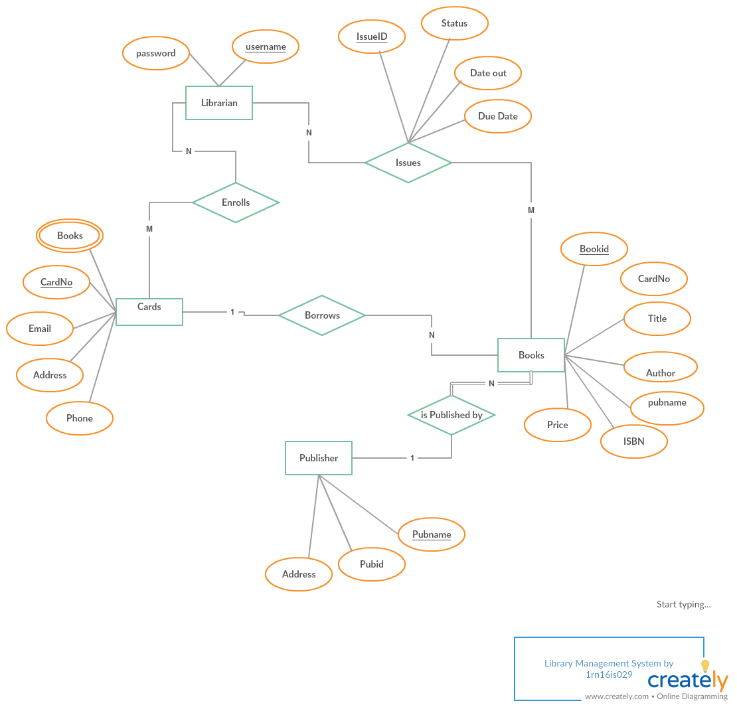
ER DIAGRAM

Slide 7
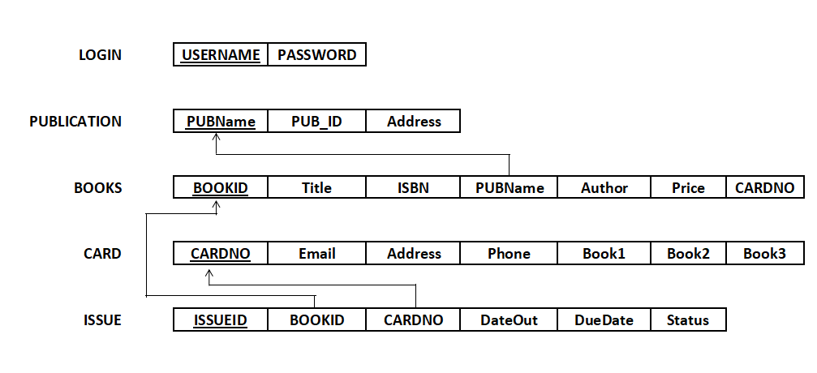
SCHEMA DIAGRAM

Slide 8
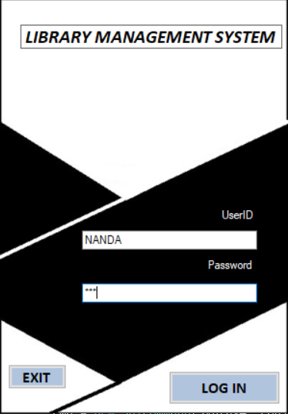
SNAPSHOTS OF WORKING PROJECT
Librarian Enters Username
Librarian Enters Password
If the correct user name and password are entered
it redirects to Home Page Else it shows Message to
enter valid username and Password

Slide 9
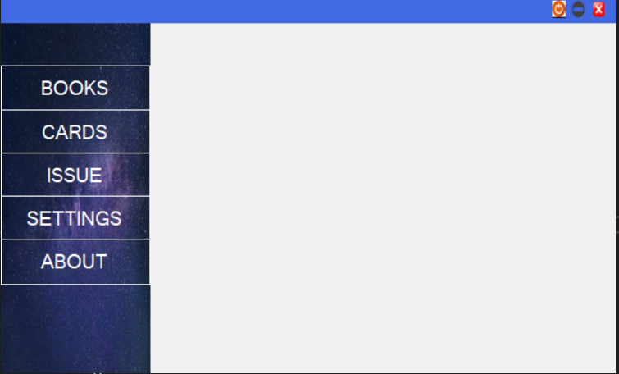
Home Page

Slide 10
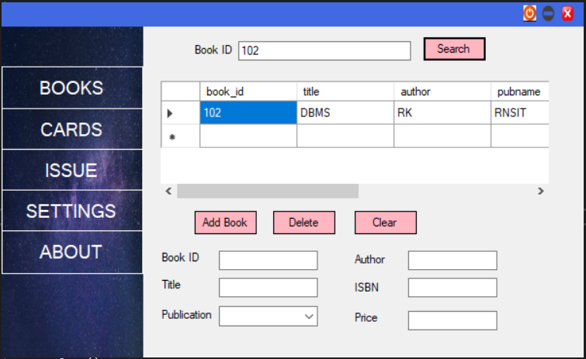
Interface to Search, Add and Delete Book data

Slide 11
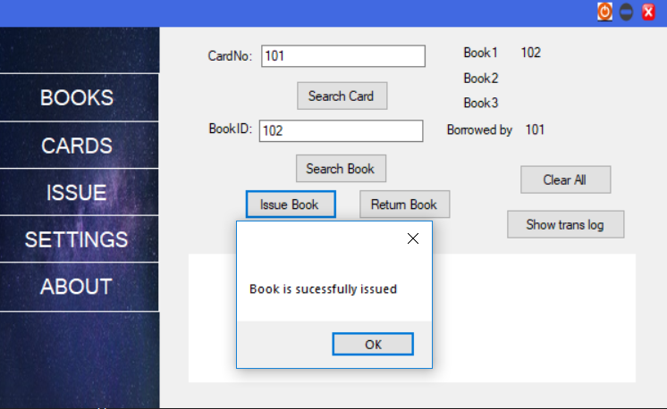
Interface to Issue and Return Book

Slide 12
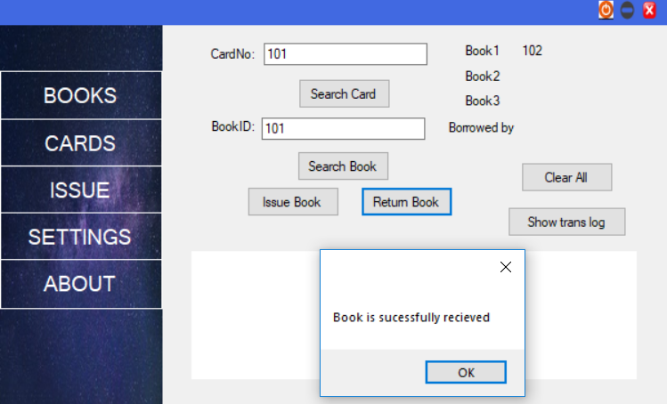
Returning Book Process

Slide 13
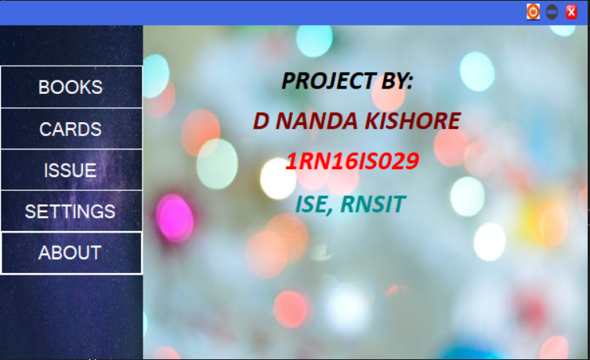
About

Slide 14
Application
This software can be used in Library for managing books, card holders , issuing and returing of books. It is provided with a secure LOGIN- only Librarians with valid user name and password can access and modify the data.

Slide 15
Conclusion
This application, Library Management System will replace the system of maintaing books in the Library. Searching of books, issueing it and maintaining records of Card holders in the library will be made easier using this project.
The main features of this project are providing user-friendly interface for the Librarian and it also avoids carrying out the work manually and reduces the wastage of paper as everything is done electronically .

Slide 16
Future Enhancements
This is a stand alone application. This can be made into a web based application where only a Librarian can login and access the data. A seperate interface can be made for card holders to Log into this user interface, Search the books, their availibity and Reserve Books.
This project is a simple demonstration of how library mangement System can be implemented for small libraries across the world. More Advanced Designs can be made depending on the number of Card holders, books , fine management and so on.
The Future Enhancements of this project is limitless.

Slide 17

Q & A

Slide 18


